Slide 1

Welcome to Ticketverse
Event and ticket booking system

Slide 2

About Us –
TicketVerse , which is also known as “The Event and ticket booking system” is a process where the consumer directly book the ticket online.
This application helps the merchants to sell their tickets online .
It is basically made for providing the customer an anytime and anywhere service for booking the seat in the cinema hall and to gather information about the movies.

Slide 3

Springboot framework in JAVA
The TicketVerse uses Springboot framework in JAVA. Springboot makes it easy to create stand alone , production – grade Spring based Applications that you can “just run”.Spring Boot makes it easy to create stand-alone, production-grade Spring based Applications that you can "just run".
It provides an easier and faster way to set up, configure, and run both simple and web-based applications.

Slide 4
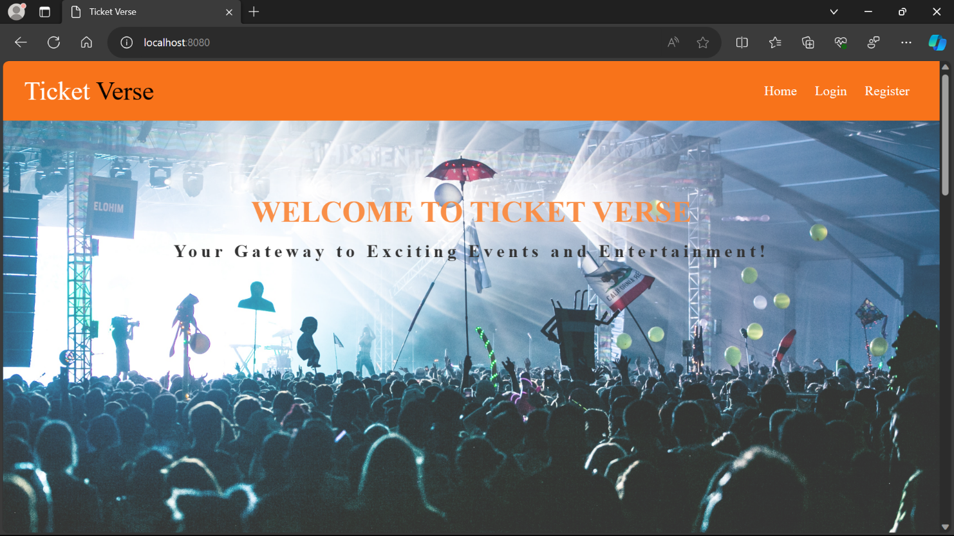
Some Screenshots of TicketVerse -

Slide 5
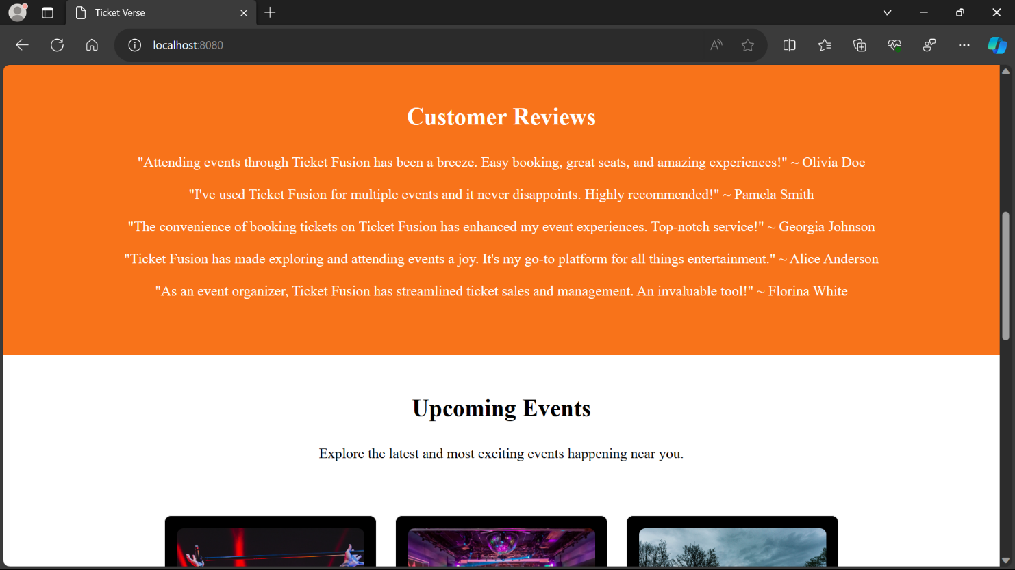
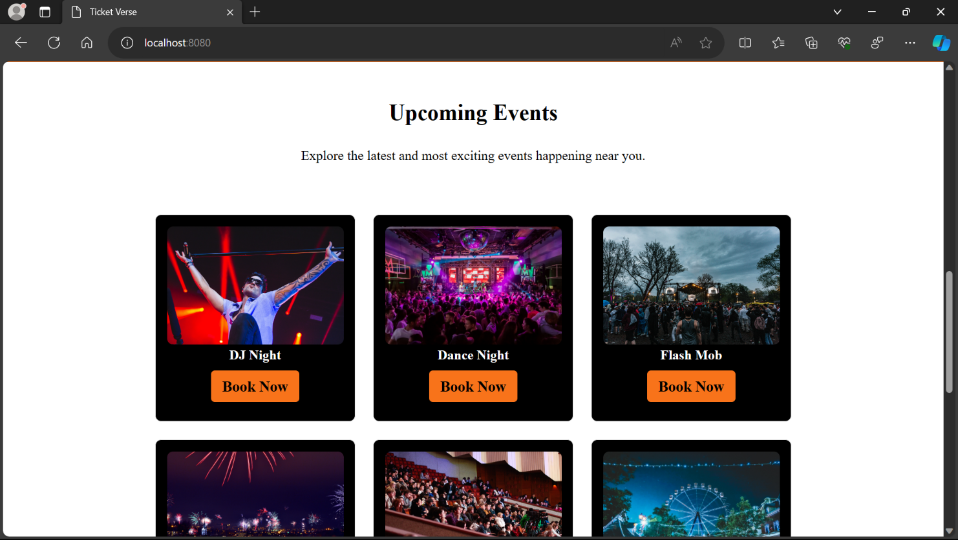

Slide 6
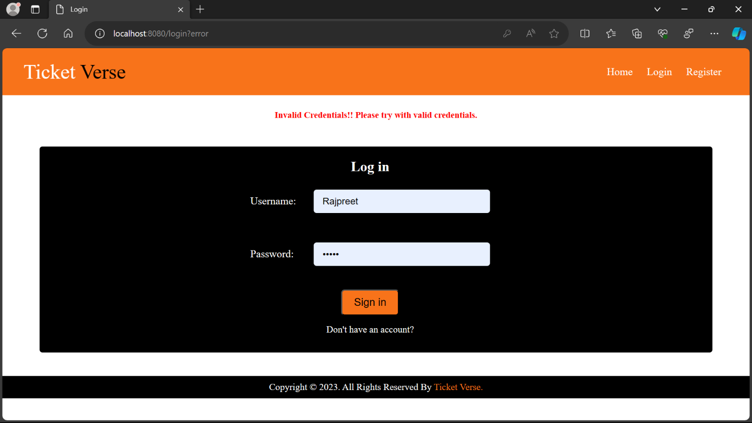
Login page-

Slide 7
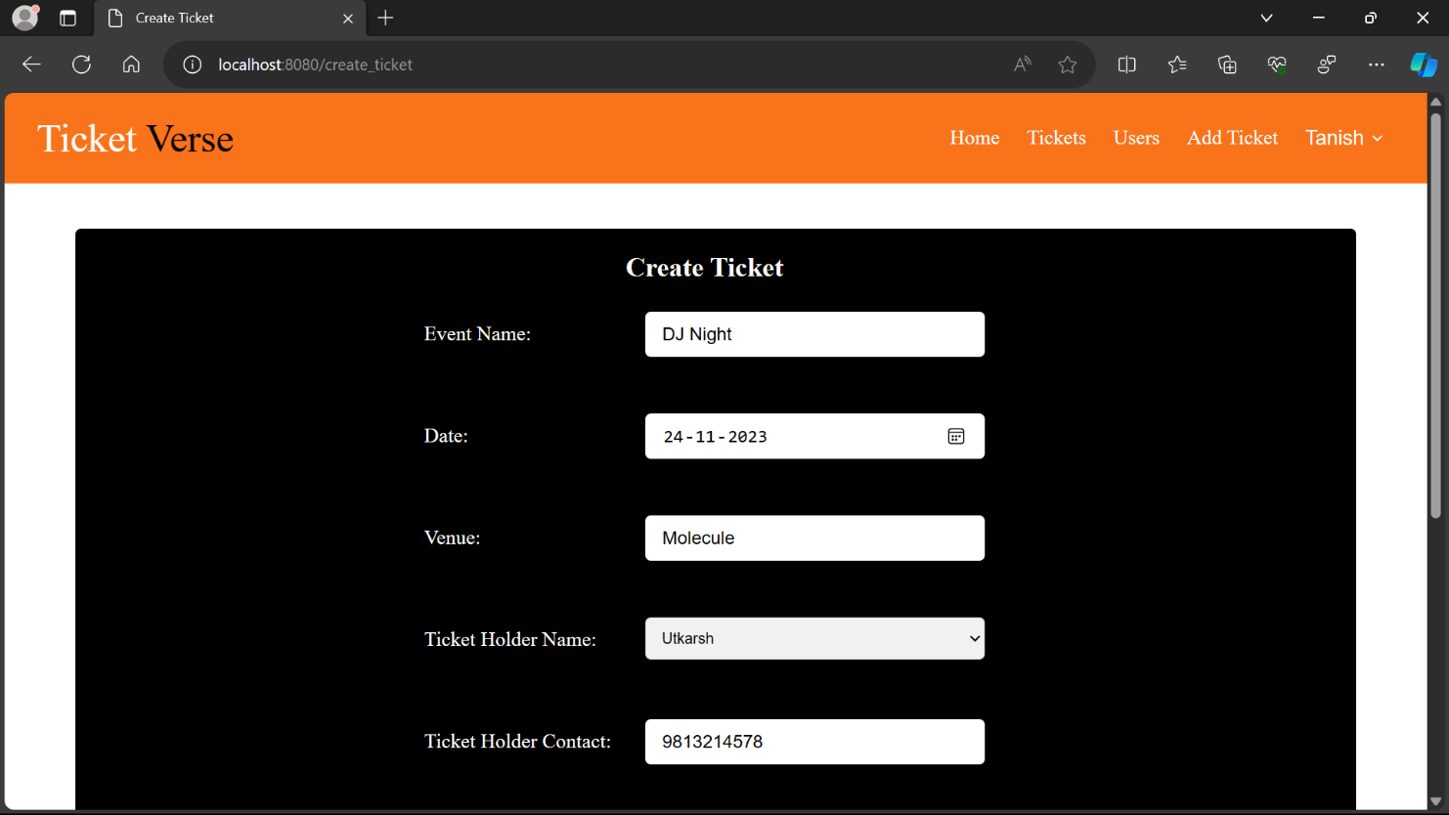
Tickets by merchants-

Slide 8
THANK YOU
TICKETVERSE

